Slide 1
Introduction to Biblical Interpretation Lecture 1
Shepherds College
Scott Jacobsen, Instructor

Slide 2
The Crisis of Biblical Authority
Rising Biblical Illiteracy
Confusion
Crisis in authority
Crisis in Biblical sufficiency

Slide 3
Sources of Crisis
Roman Catholicism: tradition and Scripture on equal footing
Pseudo-scientific doubt
Radical subjectivism
Ignorance of Scripture in the church
Refusal to submit to an authoritative Word

Slide 4
Resolving the Crisis
A new submission to Biblical Authority and Sufficiency
A renewed commitment to training preachers in the Word of God
A growing appreciation for Scripture in the Church
A demand to measure all things by Scripture
Experiences
Doctrines
Personal life
Church life

Slide 5
Introduction
How this course works
What I expect from you
Assumptions and Presuppositions

Slide 6
Introduction
Communication:
Where to find course notes
https://mountainviewchristian.ca/shepherds-college/
scott.j@sympatico.ca
Please send an email today to this address, so we can establish secure communication.
You may add me as a friend on Facebook; however do not use Facebook messaging or chat for course purposes. I will likely miss your message.

Slide 7
Downloading Powerpoint
It is important that you download the PowerPoint Presentation before class if available. You aren’t expected to read it or to view it but have it on your computer.
Using PowerPoint on your own computer makes it much easier for all of us.
You may use a tablet or smartphone, but I cannot guarantee the quality of the presentation on those devices.

Slide 8
How this course works
Syllabus: https://mountainviewchristian.ca/wp-content/uploads/2024/09/Syllabus-2024-Fall-Interpretation.pdf
Textbooks
Q&A from Grasping God’s Word.
Reading plan
Interpretation assignments
Vocabulary
Lectures

Slide 9
Syllabus
The syllabus is essential to the course. please read it immediately.
Ask or email any of your questions or concerns. If there is something you don’t understand, now is the time to get an answer.

Slide 10
Textbooks
Rational for these texts
Reading plan is in syllabus
Q&A from Grasping God’s Word will be a daily event. Be prepared.

Slide 11
Reading Plans
Assigned Books and Number of Chapters Contained | Week | ü | Read Each Week | Read Daily
Galatians--6 | Week 1 |  | Read Psalms with the intent of finishing the entire book by the end of the course. Keep in mind that this comes out to about 11.5 Psalms per week, but Psalm 119 is very long. Medieval monks read through the entire book of Psalms every week. | Each day complete your readings to finish the week’s assignment. Each day read one chapter of Proverbs, repeat each month.
Ephesians--6 | Week 2
Philippians--4 | Week 3
Colossians--4 | Week 4
1 Samuel – 2 Samuel – 55 | Week 5-6
Isaiah 66 | Week 7-8
Romans 16 | Week9
Matthew 28 | Week 10
Psalms 150 | Daily
Proverbs 31 | Daily
366

Slide 12
Interpretation Assignments
Rather than a major paper, each student will prepare an interpretation assignment over an assigned text.
Outlines will be provided.
Students will present their findings to the entire class.

Slide 13
Lectures
Lectures with PowerPoint will be an integral part of the course. They are not as of yet recorded, so do not depend upon the PowerPoint only.
There may be supplemental videos or slides from other sources.
I will assume that the assigned readings are done prior to class.

Slide 14
What I expect from you
I expect you to read the syllabus, and then do the readings in the syllabus
Textbooks
Bible readings
Projects
I expect you to download the PowerPoint presentation the night before class.
I expect you to be present on time and ready to learn

Slide 15
What I expect from you
I expect you to pay attention
I expect you to ask questions
I expect you to communicate in clearly and maturely.
I expect you to use a dictionary.

Slide 16
What is the Bible? Presuppositions
1 October 2024

Slide 17
Assumptions and presuppositions
About God
About the Bible
The Bible is the Word of God
Liberalism: the Bible contains the Word of God
Neo-Orthodoxy: the Bible becomes the Word of God when I read it.

Slide 18
Assumptions about Interpreting the Bible
Our assumptions
We can know
Language is not a human invention, but a gift of God
Meta-assumptions: Presuppositions for Biblical Interpretation
God exists
God has spoken
Man can know
Man is responsible for what he knows

Slide 19
Pitfalls
Postmodernity
Modernity
Subjectivism
Intellectualism
Shame and embarrassment

Slide 20
Pitfalls
Today’s Assumptions
Against certainty
The problem of Epistemology that isn’t a problem
Evidence and doubt and refusal to accept the evidence
Human language

Slide 21
What is Interpretation
1 October 2024

Slide 22
What is interpretation?
Key ideas
Revelation: God’s self-disclosure as opposed to man’s discovery of God.
Inspiration: God’s means of communicating His Word to man.

Slide 23
What is interpretation?
Key ideas
“Revelation is the fact of divine communication, inspiration is the means by which that communication is brought to the written record, and interpretation is the understanding of that communication. The total process of inspiration includes both the writer and the writing, although the product of inspiration is the authoritative writing and not the man. It is only the autographs (original writings) that are actually inspired, although accurate copies or translations are doctrinally authoritative, inasmuch as they correctly reproduce the original.
Norman L. Geisler and William E. Nix, A General Introduction to the Bible, Rev. and expanded. (Chicago: Moody Press, 1986), 47.

Slide 24
What is interpretation?
Key ideas
“There are no degrees of inspiration; all the Bible is equally inspired, that is, equally authoritative and true. The means or process of inspiration is a mystery of the providence of God, but the result of this process is a verbal (the words), plenary (extending to all parts equally), inerrant (errorless), and authoritative record.” There are no degrees of inspiration; all the Bible is equally inspired, that is, equally authoritative and true. The means or process of inspiration is a mystery of the providence of God, but the result of this process is a verbal (the words), plenary (extending to all parts equally), inerrant (errorless), and authoritative record.”
Norman L. Geisler and William E. Nix, A General Introduction to the Bible, Rev. and expanded. (Chicago: Moody Press, 1986), 47.

Slide 25
Interpretation
Interpretation
“The purpose of biblical interpretation is to make the meaning and message of the biblical writings plain to their readers. Some principles of interpretation are common to the Bible and other literature, especially other ancient literature; other principles of interpretation are bound up with the unique place of the Bible in the revelation of God and in the life of his people.”
F. F. Bruce, “Interpretation, Biblical,” ed. D. R. W. Wood et al., New Bible Dictionary (Leicester, England; Downers Grove, IL: InterVarsity Press, 1996), 509.

Slide 26
Interpretation and Hermeneutics
Interpretation/Hermeneutics (continued)
Hermeneutics: “the study of the locus of meaning and the principles of interpretation.” W. Randolph Tate
“The science of reflecting on how a word or an event in the past time and culture may be understood and become existentially meaningful in our present situation.” Carl Braaten
“The task of finding out the meaning of a statement for the author and for the first hearers or readers, and thereupon to transmit that meaning to modern readers.” A. B. Mickelsen

Slide 27
“Defining the rules one uses when seeking out the meaning of Scripture.” Donald McKim
“The goal of biblical hermeneutics is to bring about an active and meaningful engagement between the interpreter and text, in such a way that the interpreter’s own horizon is re-shaped and enlarged.” (the “Hermeneutical Spiral”) Anthony Thistleton
“The goal of interpretation . . . Is ‘to know the Author’s/author’s intended meaning as it is expressed in the text.’” Elliot E. Johnson
“The central problem of biblical hermeneutics [is] ‘How can the human word of a time long since vanished be understood as God’s word to the present?’” A. Oepke
The above quotations are from Graeme Goldsworthy, Gospel-Centred Hermeneutics

Slide 28
Fee and Stuart
“The aim of good interpretation is simple: to get at the ‘plain meaning of the text.’ And the most important ingredient one brings to this task is enlightened common sense. The test of good interpretation is that it makes good sense of the text. Correct interpretation, therefore, brings relief to the mind as well as a prick or prod to the heart.”
Gordon D. Fee and Douglas K. Stuart, How to Read the Bible for All Its Worth, 3rd ed. (Grand Rapids, MI: Zondervan Publishing House, 1993), 18.

Slide 29
The Reality of Interpretation
Fee and Stuart give two reasons that interpretation is necessary. It is, actually, unavoidable.
All readers interpret.
The Nature of Scripture

Slide 30
All Readers Interpret—an example from Romans 13:14
ESV
NIV84
¹⁴ But put on the Lord Jesus Christ, and make no provision for the flesh, to gratify its desires.
¹⁴ Rather, clothe yourselves with the Lord Jesus Christ, and do not think about how to gratify the desires of the sinful nature.

Slide 31
Romans 13:14
NIV84
NIV
¹⁴ Rather, clothe yourselves with the Lord Jesus Christ, and do not think about how to gratify the desires of the sinful nature.
¹⁴ Rather, clothe yourselves with the Lord Jesus Christ, and do not think about how to gratify the desires of the flesh.

Slide 32
Language Changes
NIV
Geneva Bible 1560
¹⁴ Rather, clothe yourselves with the Lord Jesus Christ, and do not think about how to gratify the desires of the flesh.
14 But put ye on the Lord Jesus Christ, and take no thoght for the flesh, to fulfil the lustes of it.
Geneva Bible (Geneva: Rovland Hall, 1560), Ro 13:14.

Slide 33
Resource
Bible Gateway has many translations and resources, in various languages.
https://www.biblegateway.com

Slide 34
What is Exegesis?
Exegesis is the careful, systematic study of the Scripture to discover the original, intended meaning.
Gordon D. Fee and Douglas K. Stuart, How to Read the Bible for All Its Worth, 3rd ed. (Grand Rapids, MI: Zondervan Publishing House, 1993), 23.

Slide 35
Doing Exegesis
The historical context
Resources:
Bible Dictionary
Introduction

Slide 36
Doing Exegesis
The literary context
Question: “What’s the point?”
“Staying on the Line”

Slide 38
Following Wycliffe’s Suggestion
What is spoken or written?
About whom is it talking about?
To whom is it talking?
What words are used?
What time?
Where was it written? Where was it sent?
What were the circumstances?
What is written immediately before, and immediately following?
Example: Mark 8:22-26. How does context matter in understanding this text?

Slide 39
Doing Exegesis
Content
Tools
A good translation
A good dictionary
Good commentaries

Slide 40
Hermeneutics
NOT our working definition—but this is the source of the word:
Hermes \ˈhər-(ˌ)mēz\ noun
[Latin, from Greek Hermēs] 14th century: a Greek god of commerce, eloquence, invention, travel, and theft who serves as herald and messenger of the other gods—compare mercury
Inc Merriam-Webster, Merriam-Websters Collegiate Dictionary. (Springfield, MA: Merriam-Webster, Inc., 2003).

Slide 41
Hermeneutics
“Although the word ‘hermeneutics’ ordinarily covers the whole field of interpretation, including exegesis, it is also used in the narrower sense of seeking the contemporary relevance of ancient texts. In this book we will use it exclusively in this way—to ask the questions about the Bible’s meaning in the ‘here and now’—even though we know this is not the word’s most common meaning.”
Gordon D. Fee and Douglas K. Stuart, How to Read the Bible for All Its Worth, 3rd ed. (Grand Rapids, MI: Zondervan Publishing House, 1993), 29.

Slide 42
Goals and Principles of Hermeneutics
To know the original intent of the author.
Hermeutics is controlled by exegesis
The dangers of subjectivism
A text cannot mean what it never meant.

Slide 43
What is Genre?
Goldsworthy begins his discussion by listing five examples.
Historical
Metaphor
Style of life
Vision
Beginning of a story
Spiritual experience

Slide 44
Genre
Broadly speaking, by genre we mean a class or group of literary texts that are marked out by certain common features that enable us to distinguish them from other texts.
Graeme Goldsworthy, Preaching the Whole Bible as Christian Scripture: The Application of Biblical Theology to Expository Preaching (Grand Rapids, MI; Cambridge: William B. Eerdmans Publishing Company, 2000), 137.

Slide 45
Pitfalls and Missing the POint

Slide 46
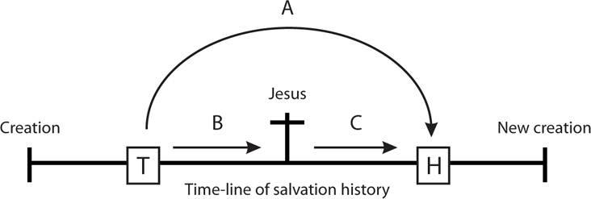
The invalid method of proceeding from text (T) to hearer (H) directly or intuitively (A) avoids the structure of revelation. The valid procedure is to trace the biblical path (B) from text to Christ and to link this with the biblical path (C) from Christ to hearer.
Graeme Goldsworthy, (Grand Rapids, MI; Cambridge: William B. Eerdmans Publishing Company, 2000), 117.

Slide 47
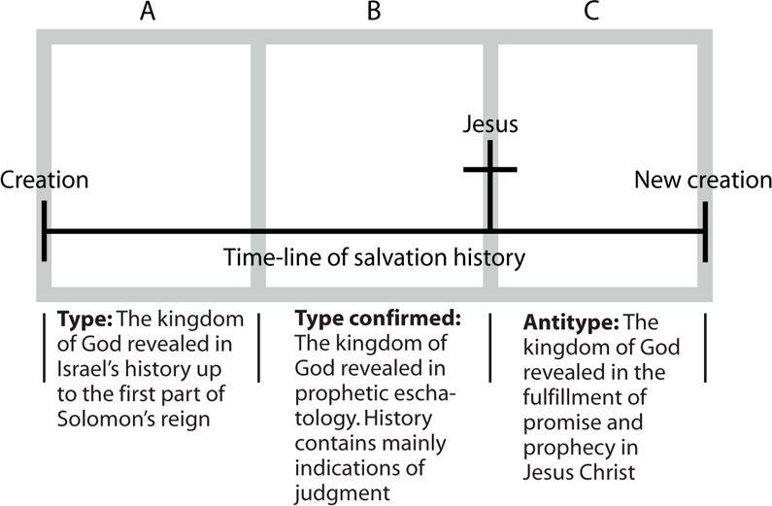

Slide 48
“That the whole Bible testifies to Christ is what we mean when we say that Christ is in all the Scriptures. It is because of this that the preacher must ask the question of every sermon, ‘Did the sermon show how the text testifies to Christ?’”
Graeme Goldsworthy, Preaching the Whole Bible as Christian Scripture: The Application of Biblical Theology to Expository Preaching (Grand Rapids, MI; Cambridge: William B. Eerdmans Publishing Company, 2000), 138.

