Slide 1
After Death Part II
21 June 2023
Mountain View Christian Church

Slide 2
What Scripture Tells us

Slide 3
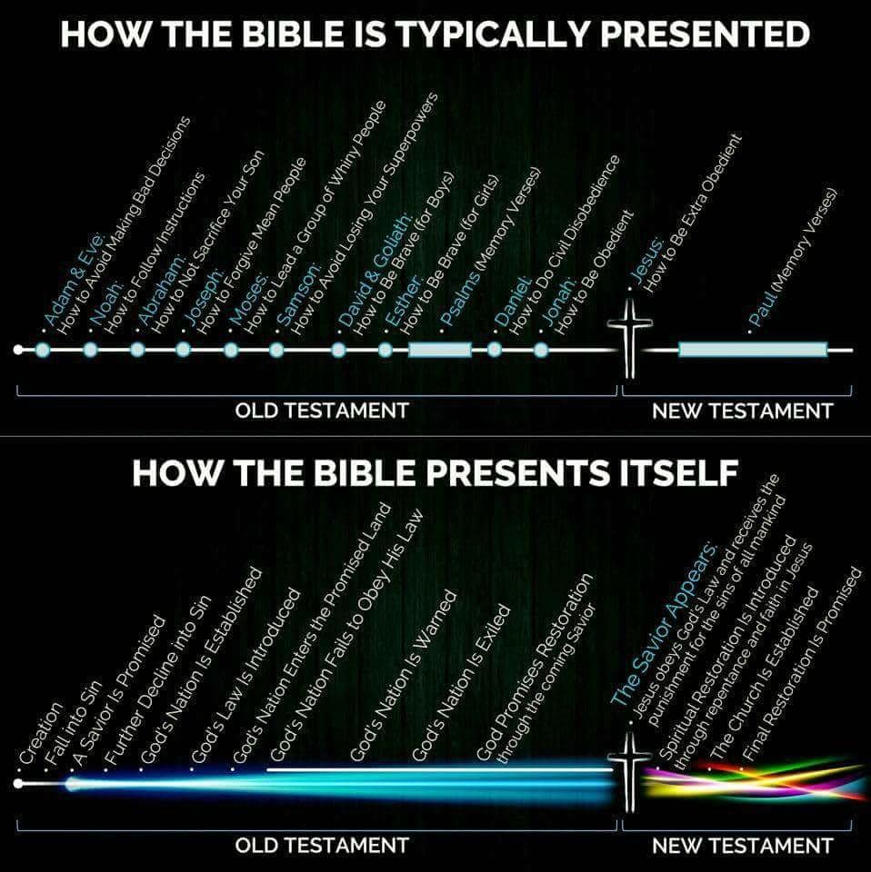

Slide 4
The Christian Knows This
We were warned
It is inevitable
It is one-way
We are changed
Intermediate State
Eternal State “in the Resurrection”

Slide 5
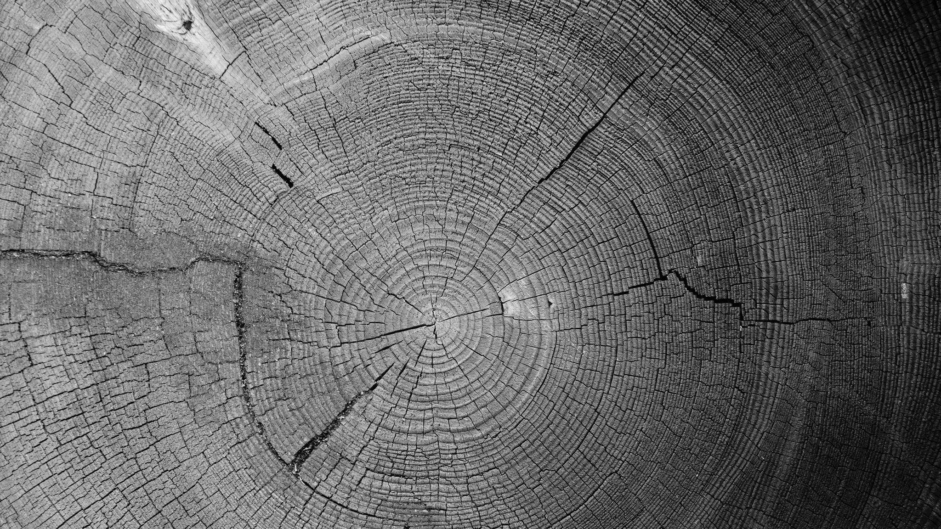
From the Apostles’ Creed
I believe in Jesus Christ, his only Son, our Lord. He was conceived by the power of the Holy Spirit and born of the virgin Mary. He suffered under Pontius Pilate, was crucified, died, and was buried. He descended to the dead. On the third day he rose again. He ascended into heaven, and is seated at the right hand of the Father. He will come again to judge the living and the dead.

Slide 6
When
2 Peter 3:7
2 Peter 3:13
Matthew 13:40–43
Matthew 25:31–32
2 Thessalonians 1:7–10
Revelation 20
Revelation 20:12

Slide 7
Day of Judgment
Matthew 11:22
Matthew 7:22
2 Thessalonians 1:10
2 Timothy 1:12
Romans 2:5

Slide 8
The Judge
1 Peter 1:17
Romans 14:10
Matthew 18:35
2 Thessalonians 1:5
Hebrews 11:6
James 4:12
1 Peter 2:23
John 5:22
Acts 17:31
2 Timothy 4:8
2 Corinthians 5:10
John 5:27
Acts 10:42
Romans 14:9
Matthew 25:32
2 Timothy 4:1

Slide 9
Who is to be Judged?
All Who Ever Lived
Matthew 25:32
Romans 2:5–6
Romans 3:6
Revelation 20
Revelation 20:12–13
Christians Included
2 Corinthians 5:10
Hebrews 10:30
Romans 14:10
James 3:1
1 Peter 4:17
Not to be Feared by Christians
Romans 8:1
1 John 4:17

Slide 10
Heidelberg Catechism 1563
QUESTION 52. What comfort is it to thee, that Christ SHALL COME AGAIN TO JUDGE THE QUICK AND THE DEAD?
That in all my sorrows and persecutions, with uplifted head, I look for the selfsame One, who has before offered Himself for me to the judgment of God and removed from me all curse, to come again as Judge from heaven; who shall cast all His and my enemies into everlasting condemnation, but shall take me, with all His chosen ones, to Himself, into heavenly joy and glory.
Heidelberg Catechism, Heidelberg Catechism, Revised Edition. (Cleveland, OH: Central Publishing House, 1907), 63.

Slide 11
What is Judged?
What was done
2 Corinthians 5:10
Matthew 25:35–40
Revelation 20:12
1 Corinthians 3:8
1 Peter 1:17
Revelation 22:12
Ephesians 6:8
Hebrews 6:10
Words Uttered
Matthew 12:36
1 Corinthians 4:5
Romans 2:16
Luke 12:2
Matthew 6:4
Matthew 6:6
Matthew 6:18
Matthew 10:26
1 Timothy 5:24–25
Sins of Believers
Isaiah 64:6
Romans 3:23
James 3:2
1 Corinthians 3:10–15

Slide 12
The Standard of Judgment
By the Light
Matthew 11:20–22
Luke 16
Luke 16:31
Romans 1:18–21
Romans 2
Romans 2:12
Romans 2:14–16
Luke 12:47–48
Relationship to Jesus
John 3:18
John 3:36
John 5:24
Romans 8:1

Slide 13
According to Works?
Matthew 16:27
Romans 2:6
Revelation 20:12
Revelation 22:12
James 2:26
The reason why the Bible teaches that the final judgment will be according to works, even though salvation comes through faith in Christ and is never earned by works, is the intimate connection between faith and works. Faith must reveal itself in works, and works, in turn, are the evidence of true faith. As John Calvin once put it, “It is … faith alone which justifies, and yet the faith which justifies is not alone.” [Anthony A. Hoekema, The Bible and the Future (Grand Rapids, MI; Cambridge, U.K.: William B. Eerdmans Publishing Company, 1994), 261.]
Galatians 5:6
Matthew 7:21
James 2:18
Matthew 25:31–46

Slide 14
Is God Just?
Since the judgment will be perfectly just, the Scriptures make clear that it will be rendered according to the light we have. What happens, then, to the innocent person who has never heard the gospel of Jesus Christ? The answer is that God never punishes innocent people. Those who are innocent have no need to worry about the judgment of God. Yet according to the New Testament, there are no innocent people. No one can come before the judgment seat of God and say, “I had no light of revelation”; that is the significance of Romans 1. There, Paul writes of God’s wrath being poured out against evildoers because they have suppressed the knowledge of God that is clear through nature. They have turned away and refused to honor God as God. Therefore, no one can stand at the judgment seat of God and claim he did not know that there was a God.

Slide 15
Is God Just?
In the last judgment, people who have never heard of Jesus will not be punished for rejecting Jesus. God judges according to the light that each one has, and it would be unjust for Him to hold people responsible for rejecting Jesus if they have never heard of Him. That being said, Jesus came to people who were already under God’s indictment—not for rejecting Jesus, whom they did not know, but for rejecting the Father, whom they did know by the revelation that He had given in nature. Even if we did not have the Bible, the heavens declare God’s glory (Ps. 19:1; Rom. 1:20). Indeed, our very consciences bear witness that we know who God is and that we have violated His law (Rom. 2:15).

Slide 16
Is God Just?
The destiny to which we will be subject at the last judgment is unalterable. Many hope for a second chance after death, even if it is a mythical purgatory where they can pay off their debts and then enter heaven, yet nothing in Scripture gives the slightest hope of that. The Bible tells us that “it is appointed for man to die once, and after that comes judgment” (Heb. 9:27).
R. C. Sproul, Everyone’s a Theologian: An Introduction to Systematic Theology (Orlando, FL: Reformation Trust, 2014), 326–327.

Slide 17
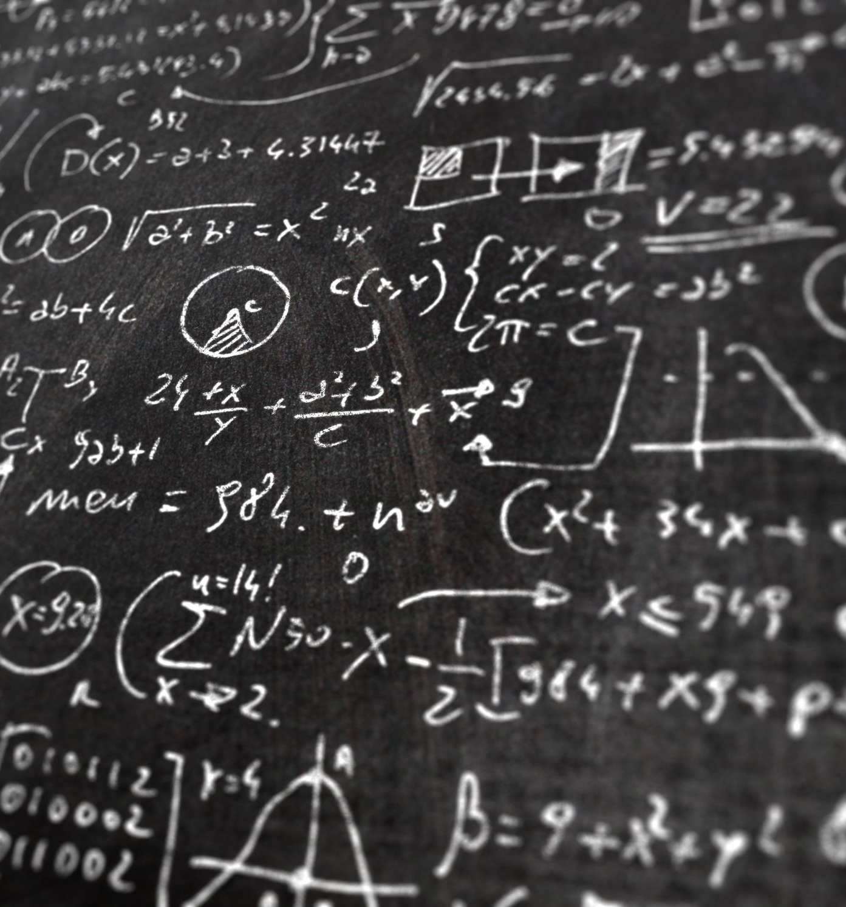
The Significance of Judgment
What, finally, is the significance of the Day of Judgment? Four observations may be made.
The history of the world is not an endless succession of meaningless cycles, but is a movement toward a goal.
The Day of Judgment will reveal finally that salvation and eternal blessedness will depend on one’s relationship to Jesus Christ.

Slide 18
The inescapableness of the Day of Judgment underscores man’s accountability for his life, and asserts the seriousness of the moral struggle in the life of every person, particularly in the life of the Christian.
The Day of Judgment means the final triumph of God and his redemptive work in history—the final and decisive conquest of all evil, and the final revelation of the victory of the Lamb that was slain. The Day of Judgment will reveal, beyond the shadow of a doubt, that in the end the will of God will be perfectly done. Anthony A. Hoekema, The Bible and the Future (Grand Rapids, MI; Cambridge, U.K.: William B. Eerdmans Publishing Company, 1994), 264.

