Slide 1
Eschatology: Matthew 24
22 March 2023
Spring

Slide 2
Opening the Text: Matthew 24
Context: Matthew 23:34–36 (ESV)
34 Therefore I send you prophets and wise men and scribes, some of whom you will kill and crucify, and some you will flog in your synagogues and persecute from town to town, 35 so that on you may come all the righteous blood shed on earth, from the blood of righteous Abel to the blood of Zechariah the son of Barachiah, whom you murdered between the sanctuary and the altar. 36 Truly, I say to you, all these things will come upon this generation.
The activity of the great tribulation
Vs 34
Purpose: full judgement
Abel to Zechariah
2 Chronicles is the last book of the Hebrew Canon.
This generation

Slide 3
Understanding the context
Geography: synagogues and town to town—local to Israel
Fulfilment: “all the blood from Abel to Zechariah” full guilt
Time: this generation

Slide 4
Context 2: Matthew 23:37-39
37 “O Jerusalem, Jerusalem, the city that kills the prophets and stones those who are sent to it! How often would I have gathered your children together as a hen gathers her brood under her wings, and you were not willing! 38 See, your house is left to you desolate. 39 For I tell you, you will not see me again, until you say, ‘Blessed is he who comes in the name of the Lord.’ ”
Geographically specific: Jerusalem
House of Jerusalem must fall
Vs 39, already happened in Matthew 21:9 (Psalm 118:26), so Jesus is saying here, “you refused to say this when the time came.”

Slide 5
Summary
Geographically limited: synagogues, towns in the area
Within this generation
Purpose to fulfill the guilt of Jerusalem
Certainty of the fall of their house
Jesus is announcing their refusal and that it is too late

Slide 6
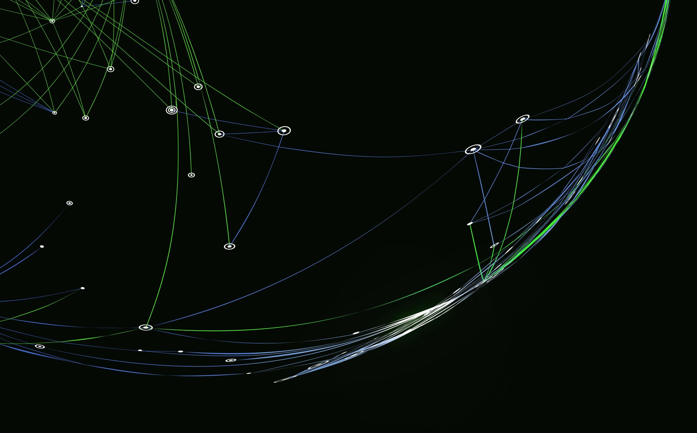
Matthew 24

Slide 7
The ultimate event
24 Jesus left the temple and was going away, when his disciples came to point out to him the buildings of the temple. 2 But he answered them, “You see all these, do you not? Truly, I say to you, there will not be left here one stone upon another that will not be thrown down.”
The destruction of the temple is a destruction of the nation.

Slide 8
Three Questions or One? Matthew 24:3
3 As he sat on the Mount of Olives, the disciples came to him privately, saying, “Tell us, when will these things be, and what will be the sign of your coming and of the end of the age?”
When will these things be?
What will be the sign of your coming?
What will be the sign of the end of the age?

Slide 9
The Questions
It is doubtful that they were asking three questions. Consider their question in Acts 1:6 “So when they had come together, they asked him, ‘Lord, will you at this time restore the kingdom to Israel?’”
The disciples, after witnessing Christ’s death, resurrection (for 40 days), were still confused at His ascension. This is why I doubt that their questions in Matthew 24:3 were precise.
The three questions, however, are answered by Christ in a manner that does not indicate great gaps in time.

Slide 10
The answers to the questions
When will these things be? –referring to the destruction of the temple
What will be the sign of your coming? –the Parousia, which is not separated from the destruction of the temple.
What will be the sign of the end of the age? –the end of the age, suntelias, refers to the closure of a time.

Slide 11
Parousia
Usually means coming of the Lord, but can also mean coming in a very human sense: 6 But God, who comforts the downcast, comforted us by the coming of Titus, 7 and not only by his coming but also by the comfort with which he was comforted by you, as he told us of your longing, your mourning, your zeal for me, so that I rejoiced still more.
2 Corinthians 7:6-7

Slide 12
Matthew 13:39 and the enemy who sowed them is the devil. The harvest is the end of the age, and the reapers are angels.
Matthew 13:40 Just as the weeds are gathered and burned with fire, so will it be at the end of the age.
Matthew 13:49 So it will be at the end of the age. The angels will come out and separate the evil from the righteous
Matthew 24:3 As he sat on the Mount of Olives, the disciples came to him privately, saying, “Tell us, when will these things be, and what will be the sign of your coming and of the end of the age?”
Matthew 28:20 teaching them to observe all that I have commanded you. And behold, I am with you always, to the end of the age.”
Hebrews 9:26 for then he would have had to suffer repeatedly since the foundation of the world. But as it is, he has appeared once for all at the end of the ages to put away sin by the sacrifice of himself.

Slide 13
Jesus’ response
4 And Jesus answered them, “See that no one leads you astray. 5 For many will come in my name, saying, ‘I am the Christ,’ and they will lead many astray. 6 And you will hear of wars and rumors of wars. See that you are not alarmed, for this must take place, but the end is not yet. 7 For nation will rise against nation, and kingdom against kingdom, and there will be famines and earthquakes in various places. 8 All these are but the beginning of the birth pains.

Slide 14
Closer to the end
9 “Then they will deliver you up to tribulation and put you to death, and you will be hated by all nations for my name’s sake. 10 And then many will fall away and betray one another and hate one another. 11 And many false prophets will arise and lead many astray. 12 And because lawlessness will be increased, the love of many will grow cold. 13 But the one who endures to the end will be saved. 14 And this gospel of the kingdom will be proclaimed throughout the whole world as a testimony to all nations, and then the end will come.

Slide 15
Events to expect
Being delivered up (betrayed, arrested, handed over) to tribulation.
Put to death
Hated
Witnesses to apostasy
Betrayal
Hate
False prophets
Lawlessness resulting in love growing cold

Slide 16
Promise and Timing
13 But the one who endures to the end will be saved. 14 And this gospel of the kingdom will be proclaimed throughout the whole world as a testimony to all nations, and then the end will come.
Endurance
The Gospel proclamation to the whole world.
Could this have happened? Next slide!

Slide 17
The whole world as a timing of the end
Question: if the Gospel of the Kingdom must be proclaimed throughout the whole world, to all the nations, does that mean that Christ’s coming is delayed until that has occurred?
See Luke 2:1. What is meant by the whole world?
Acts 24:5; 11:25; 19:27
By the end of the writing of the New Testament, the Gospel had been spread to the entire know world.

Slide 18
More on that:
Col 1:23, 6; Ro 1:8; 16:26; 2 Ti 4:17; Ro 15:24, 28; Ps 19:4; Ro 10:18

