Slide 1
Eschatology: 666 The Mark of the Beast
8 February 2023
Winter

Slide 2
The Mark of the Beast
The texts:
1 Kings 10:14 Now the weight of gold that came to Solomon in one year was 666 talents of gold,
2 Chronicles 9:13 Now the weight of gold that came to Solomon in one year was 666 talents of gold,
Ezra 2:13 The sons of Adonikam, 666.
Revelation 13:18 This calls for wisdom: let the one who has understanding calculate the number of the beast, for it is the number of a man, and his number is 666.

Slide 3
The Mark
ch. 11:18; Prov. 3:3; 6:21; 7:3; See Ex. 13:9
The Holy Bible: English Standard Version (Wheaton, IL: Crossway Bibles, 2016).

Slide 5
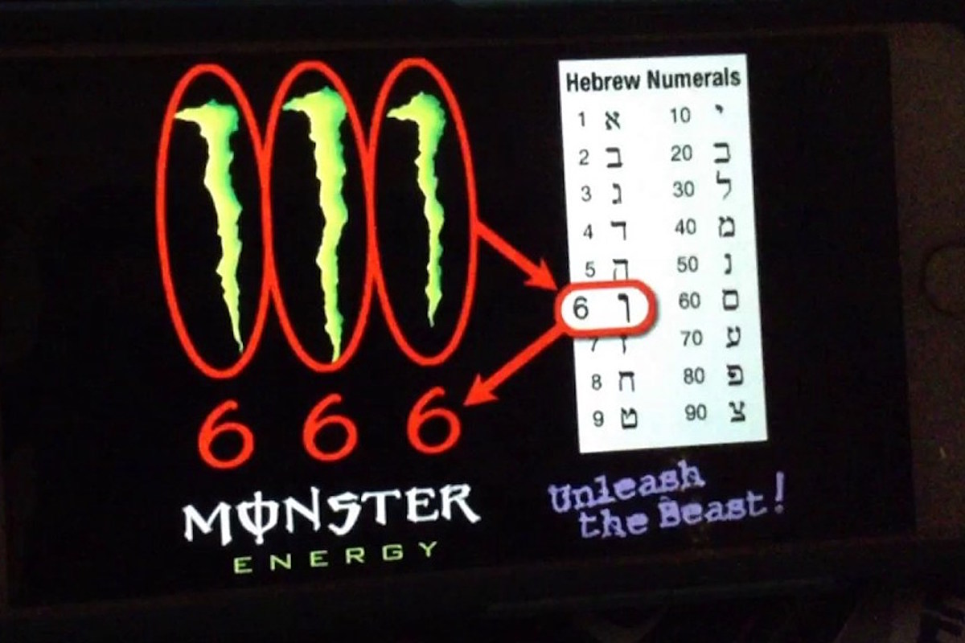

Slide 6
What the Bible Says: Revelation 13:11–18 (ESV)
11 Then I saw another beast rising out of the earth. It had two horns like a lamb and it spoke like a dragon. 12 It exercises all the authority of the first beast in its presence, and makes the earth and its inhabitants worship the first beast, whose mortal wound was healed. 13 It performs great signs, even making fire come down from heaven to earth in front of people, 14 and by the signs that it is allowed to work in the presence of the beast it deceives those who dwell on earth, telling them to make an image for the beast that was wounded by the sword and yet lived. 15 And it was allowed to give breath to the image of the beast, so that the image of the beast might even speak and might cause those who would not worship the image of the beast to be slain. 16 Also it causes all, both small and great, both rich and poor, both free and slave, to be marked on the right hand or the forehead, 17 so that no one can buy or sell unless he has the mark, that is, the name of the beast or the number of its name. 18 This calls for wisdom: let the one who has understanding calculate the number of the beast, for it is the number of a man, and his number is 666.

Slide 7
Revelation 13:11-20
Another beast
Two horns
Spoke like dragon
Exercises authority
Makes the inhabitants of the earth worship the first beast
Great but deceptive signs
Gave breath to the image of the first beast
Caused those who refused to worship the image of the first beast to be slain.
Demands total obedience and loyaly as shown by the mark

Slide 8
Revelation 13:11-20—the Mark
All people
Commerce
The number is the number of its name
The name is the name of a man
The number is 666
Not three “sixes”
Six hundred and sixty-six
ἑξακόσιοι ἑξήκοντα ἕξ
Hexakosioi (six-hundred)
Hexekonta, (sixty)
Hex (six)

Slide 9
What the Bible doesn’t say
Receiving the Mark of the Beast is unwilling
A person can be deceived into taking it (accident)
A person will be forced to receive it.

Slide 10
Getting the number right
666 is a number, not three sixes.
The number had to make sense to the readers in the 1st century (Revelation 1:1)

Slide 11
Nero Caesar
The Hebrew Christians would refer to Nero Caesar as nrwn ksr. The first century Hebrews wrote (as confirmed in archaeology) that this was the name of Nero, in Hebrew. נִירוֹן pr. n. m. Nero, the Roman emperor
n=50, r=200, w=6, n=50, q=100, s=60, r=200 = 666.
The Monster Drink people are saying six sixes, or www

Slide 12
Neron ksar נִרֹן נִרוֹן 200+60+100+50+200+6+50=

Slide 13
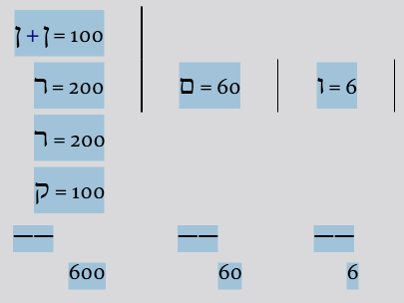
It explains every reference in our text: see notes on 13:1, 3, 12, 14, and on the present verse.
It explains the twofold reading 666 and 616. In C, two lost cursives and Tyconius (see Iren. v. 30. 1), the reading 616 occurs instead of 666. This can be explained from the Latin form of the name Nero, which by its omission of the final n makes the sum total 616 instead of 666.
It satisfies the numerical method

Slide 14
Nero
Nero had his mother bludgeoned and slashed to death by marines ordered to do the job after his attempts to poison and drown her failed. A few years later, he had his wife, Octavia, killed so he could marry his mistress, Poppaea. He kicked Poppaea to death when she complained about him coming home late. The Roman historian Suetonius reported that Nero “castrated the boy Sporus and actually tried to make a woman of him; and he married him with all the usual ceremonies … and treated him as his wife.” His other sexual exploits are too degrading to put into print. But his persecution of Christians led the first-century church to regard Nero as Revelation’s “beast” in confirmation of what they read in Revelation. Miriam Griffin, tutor in ancient history and Fellow of Somerville College, Oxford, writes, “In A.D. 64 came the most serious threat to Nero’s popularity when the Great Fire broke out. It was widely believed that Nero first used the blaze as a backdrop for a virtuoso performance and then restarted it to clear the ground for his reconstruction of Rome. This time, force was used on a despised minority, the Christians, who were burned alive to illuminate circus games.”
Rumors circulated that Nero had set the fire. “Nero first attempted to quash the rumours by religious ceremonies designed to appease the supposedly angry gods.” He needed a scapegoat, “so he decided to fasten guilt on a human culprit, the Christians,” using them as “human torches.” John said of the Beast, “It was also given to him to make war with the saints and to overcome them” (Rev. 13:7).
Gary DeMar, Left Behind: Separating Fact from Fiction (Powder Springs, GA: American Vision, 2009), 146.

Slide 15
666
Ezekiel 9:2 And behold, six men came from the direction of the upper gate, which faces north, each with his weapon for slaughter in his hand, and with them was a man clothed in linen, with a writing case at his waist. And they went in and stood beside the bronze altar.
Ezekiel 9:4 And the Lord said to him, “Pass through the city, through Jerusalem, and put a mark on the foreheads of the men who sigh and groan over all the abominations that are committed in it.”
2 Corinthians 1:22 and who has also put his seal on us and given us his Spirit in our hearts as a guarantee.
2 Timothy 2:19 But God’s firm foundation stands, bearing this seal: “The Lord knows those who are his,” and, “Let everyone who names the name of the Lord depart from iniquity.”
Revelation 7:2–3 2 Then I saw another angel ascending from the rising of the sun, with the seal of the living God, and he called with a loud voice to the four angels who had been given power to harm earth and sea, 3 saying, “Do not harm the earth or the sea or the trees, until we have sealed the servants of our God on their foreheads.”
Isaiah 44:5 his one will say, ‘I am the Lord’s,’ another will call on the name of Jacob, and another will write on his hand, ‘The Lord’s,’ and name himself by the name of Israel.”
Revelation 7:3 saying, “Do not harm the earth or the sea or the trees, until we have sealed the servants of our God on their foreheads.”
Revelation 9:4 They were told not to harm the grass of the earth or any green plant or any tree, but only those people who do not have the seal of God on their foreheads.

Slide 16
The anti-worship
Deuteronomy 6:1–9 (ESV)
The Greatest Commandment
6 “Now this is the commandment—the statutes and the rules—that the Lord your God commanded me to teach you, that you may do them in the land to which you are going over, to possess it, ² that you may fear the Lord your God, you and your son and your son’s son, by keeping all his statutes and his commandments, which I command you, all the days of your life, and that your days may be long. ³ Hear therefore, O Israel, and be careful to do them, that it may go well with you, and that you may multiply greatly, as the Lord, the God of your fathers, has promised you, in a land flowing with milk and honey.
⁴ “Hear, O Israel: The Lord our God, the Lord is one. ⁵ You shall love the Lord your God with all your heart and with all your soul and with all your might. ⁶ And these words that I command you today shall be on your heart. ⁷ You shall teach them diligently to your children, and shall talk of them when you sit in your house, and when you walk by the way, and when you lie down, and when you rise. ⁸ You shall bind them as a sign on your hand, and they shall be as frontlets between your eyes. ⁹ You shall write them on the doorposts of your house and on your gates.

Slide 17
The line of thought referred to merely expresses the idea, that the Israelites were not only to retain the commands of God in their hearts, and to confess them with the mouth, but to fulfil them with the hand, or in act and deed, and thus to show themselves in their whole bearing as the guardians and observers of the law.
Carl Friedrich Keil and Franz Delitzsch, Commentary on the Old Testament, vol. 1 (Peabody, MA: Hendrickson, 1996), 343–344.

